Slide 1
Memory allocation simulator(first Fit ,Best fit algorithm )
Presented by:
Vivek sai {24KB1A0510}
Purna kumar{24KB1A028}
Akshay {24KB1A0567}
Vamsi {24KB1A05DO}
Vikram {24KB1A04D1}

Slide 2
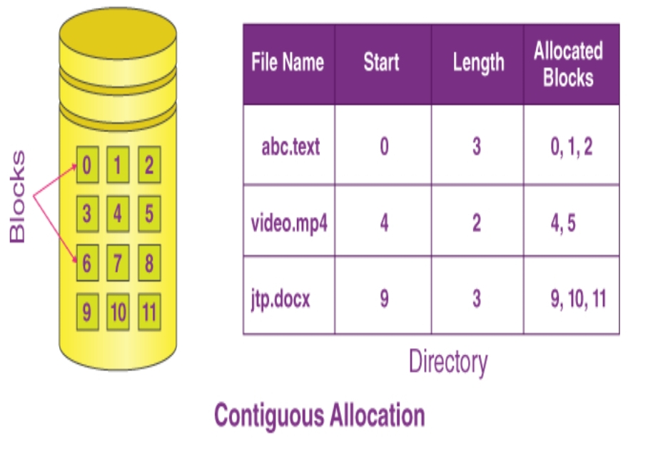
Introduction Of memory allocation:
Memory allocation is a Crucial process in opareting systems that manages how memory is Allocated process.
Efficient memory allocation ensures Optimal use of system resources and can Prevent fragmentation.
This presentation will explore two popular algorithms :1. First Fit , 2.Best Fit

Slide 3
Objective:
The objective of memory allocation in both First-Fit and Best-Fit algorithms is to find a suitable block of memory to allocate to a process

Slide 4
Why C and Data structure
Advantages of c:
1.High performance And efficiency
2.Precious memory control for simulation.
Role of Data structure:
Essential role For managing.

Slide 5
Algorithm:
Processes of and the problem.
2.You have a set of memory blocks of different sizes.
3.You want to allocate Procesess certain sizes to these blocks.
4.First Fit: Allocate the first block large enough.
5.Best Fit: Allocates the smallest block that is large enough.

Slide 6
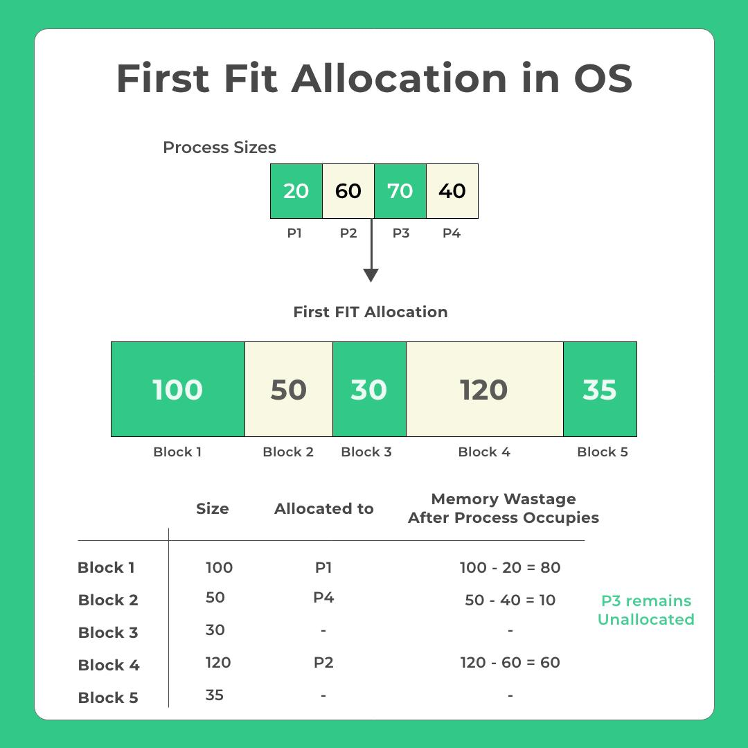
First Fit algorithm :
The first Fit algorithm allocates The first block of memory that is large Enough to satisfy the request.
It scans memory from the beginning and stops as soon as it finds a suitable block.
This method is generally Faster but can lead to external Fragmentation Over time.

Slide 7
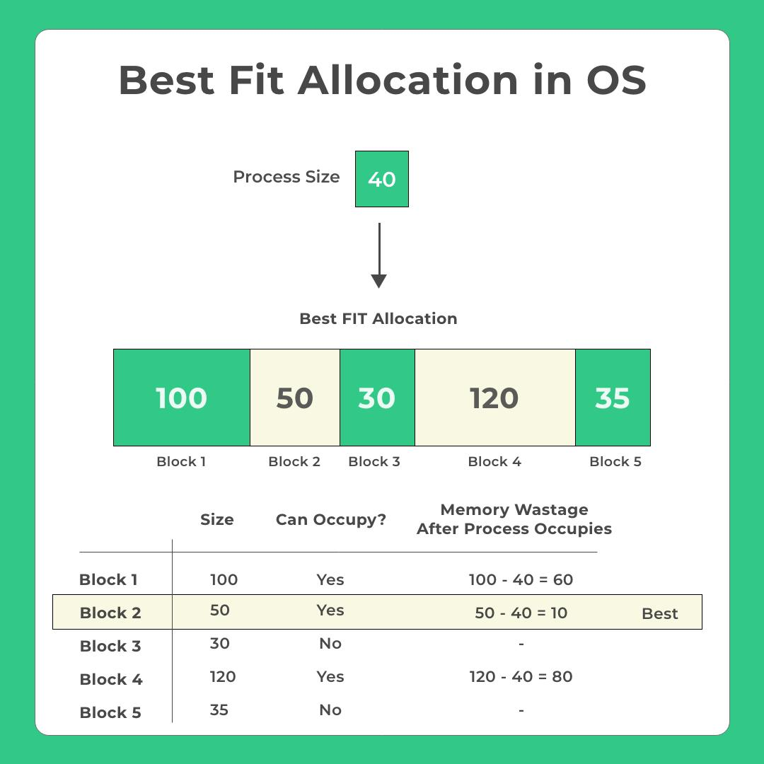
Best Fit algorithm:
The Best Fit algorithm Searches for smallest available block that meets the memory Requirement.
It aims to minimise Wasted space by Efficiently using available memory.
However, it often requires More time to search and can lead to increase fragmentation.

Slide 8
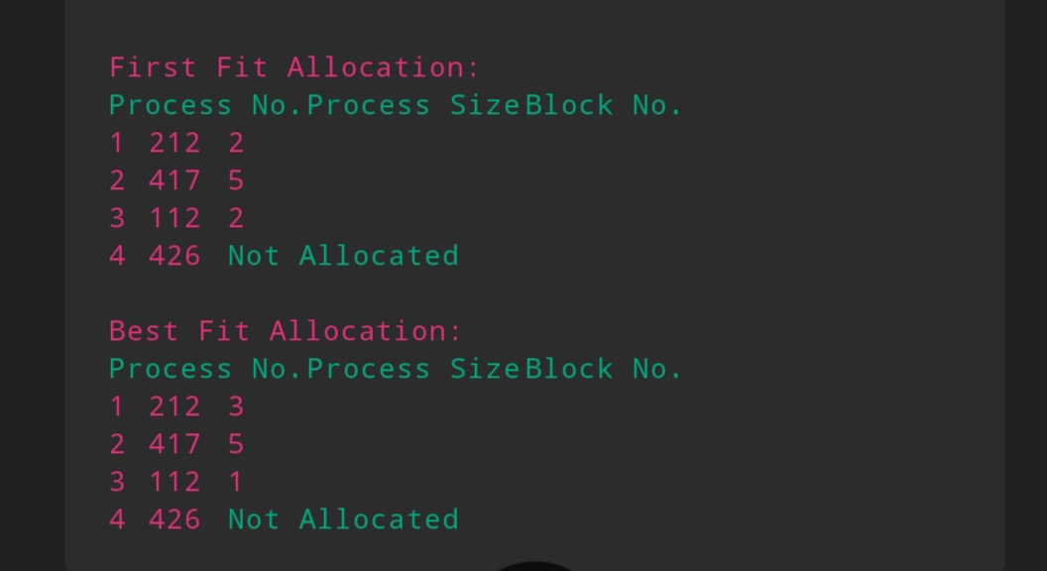
Sample outputs

Slide 9


